Slide 1

Akash Devulapally
07/24/2024

Slide 2

Outline
Summary
Introduction
Methodology
Results
Conclusion
Appendix

Slide 3
Executive Summary
Summary of methodologies
Summary of all results

Slide 4
Introduction
Project background and context
Problems you want to find answers

Slide 5

Section 1

Slide 6
Methodology
Summary
Collecting data methodology:
Describe how data was collected
Perform Data Wrangler
Describe how data was processed
Perform exploratory data analysis (EDA) using visualization and SQL
Perform interactive visual analytics using Folium and Plotly Dash
Perform predictive analysis using classification models
How to build, tune, evaluate classification models

Slide 7
Data Collection
Data collection involves gathering information from various sources to be used for analysis and decision-making. This process can include both primary data, which is collected directly through methods like surveys, interviews, and experiments, and secondary data, which is obtained from existing sources such as databases, reports, and online resources. Data collection methods vary depending on the nature and scope of the study, ranging from automated data capture using sensors and web scraping to manual entry and archival research. Ensuring data quality and accuracy is crucial, often involving steps like validation, cleaning, and preprocessing before the data is ready for analysis. The goal is to compile a comprehensive dataset that is representative of the target population or phenomena being studied.

Slide 8
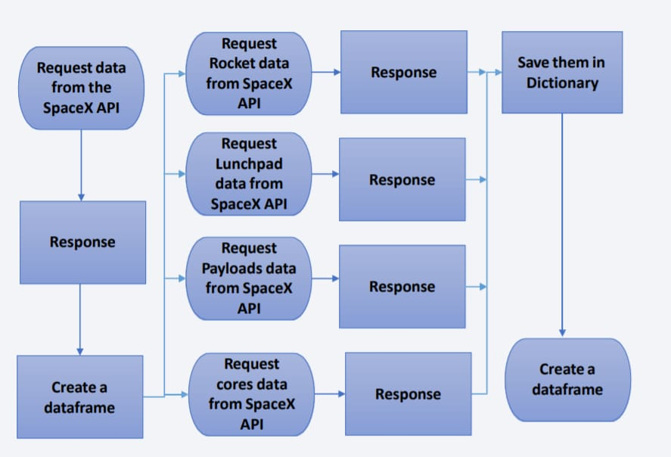
Data Collection – SpaceX API
Present your data collection with SpaceX REST calls using key phrases and flowcharts
Add the GitHub URL of the completed SpaceX API calls notebook (must include completed code cell and outcome cell), as an external reference and peer-review purpose

Slide 9
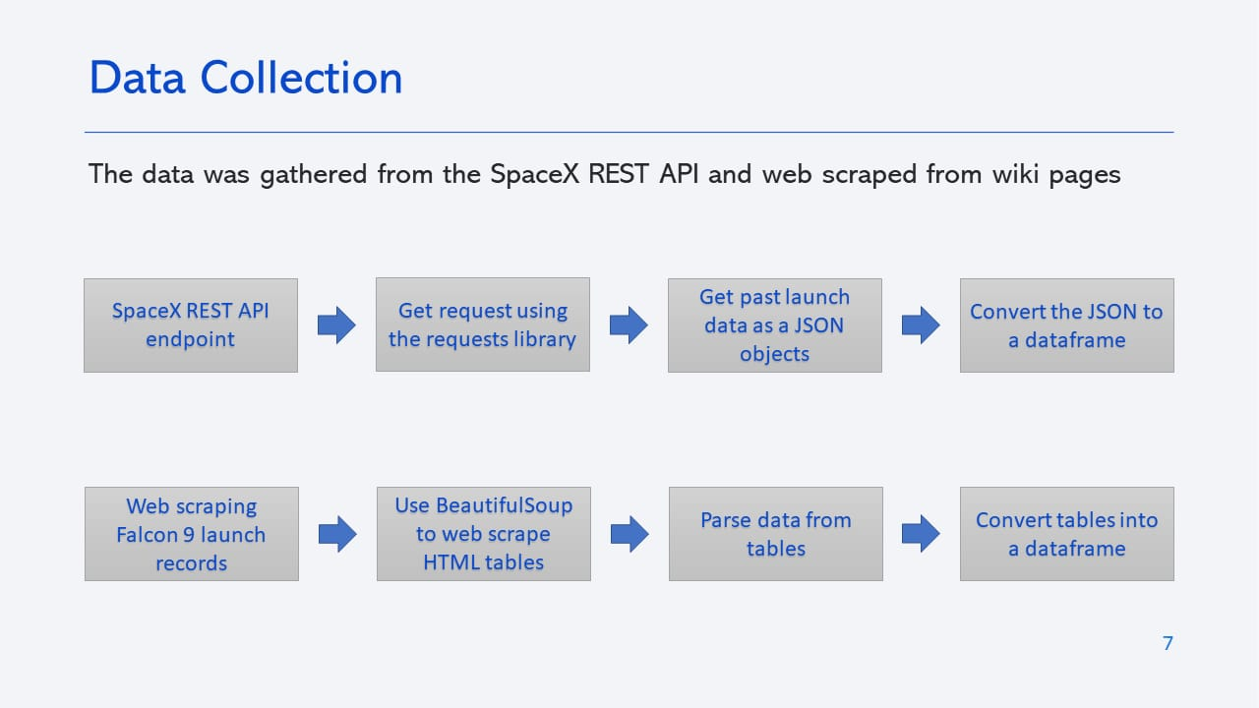
Data Collection - Scraping
Present your web scraping process using key phrases and flowcharts
Add the GitHub URL of the completed web scraping notebook, as an external reference and peer-review purpose

Slide 10
Data Wrangler
*Data Cleaning and Preprocessing:* This involves handling missing values, removing duplicates, correcting inconsistencies, and converting data types. Effective data cleaning ensures that the dataset is accurate and reliable, leading to better analysis and insights.
*Feature Engineering:* Creating new features from raw data that better represent the underlying problem to the predictive models. This can involve combining existing features, creating interaction terms, or applying domain knowledge to generate meaningful attributes. Feature engineering can significantly enhance the performance of machine learning models.

Slide 11
EDA with Data Visualization
*Identifying Patterns and Trends:* Data visualization in EDA helps uncover underlying patterns, trends, and relationships in the data. Charts like histograms, scatter plots, and line graphs make it easier to understand the distribution of variables, spot correlations, and detect outliers, leading to more informed analysis and decision-making.
*Simplifying Complex Data:* Visualization simplifies complex datasets, making them more accessible and understandable. By transforming large amounts of data into visual formats, it becomes easier to communicate findings to stakeholders, highlight key insights, and support data-driven decision-making processes.

Slide 12
EDA with SQL
Data Exploration and Summarization: SQL allows for efficient querying and summarization of large datasets. Techniques such as aggregation (using GROUP BY and aggregate functions like SUM, AVG, COUNT) and filtering (WHERE clauses) enable quick insights into data distributions, trends, and anomalies. This helps in understanding the overall structure and key characteristics of the data.
Joining and Merging Data: SQL is powerful for combining data from multiple tables using JOIN operations. This is crucial for EDA when data is stored in relational databases across different tables. By effectively joining tables, you can create comprehensive datasets that integrate various sources of information, enabling more detailed and thorough exploratory data analysis.

Slide 13
Build an Interactive Map with Folium
Visualizing Geospatial Data: Folium allows you to create interactive maps that effectively display geospatial data. You can add markers, pop-ups, and layers to represent different data points and regions. This makes it easy to identify geographical patterns and insights, such as clustering of events, hotspots, or distribution of phenomena across different locations.
Customization and Interactivity:Folium provides extensive customization options, including various map styles, color schemes, and tooltips. Interactive features like zooming, panning, and clicking on markers for more information enhance user engagement and data exploration, making the maps more informative and user-friendly for presentations and reports.

Slide 14
Build a Dashboard with Plotly Dash
Interactive Data Visualization: Plotly Dash enables the creation of interactive dashboards that allow users to explore data through various visualizations like bar charts, line graphs, scatter plots, and more. Users can interact with these visualizations by zooming, hovering, and selecting data points, which provides a more dynamic and engaging way to analyze data.
Real-Time Data Updates: Dash allows for real-time data updates and user input handling, making it ideal for dashboards that need to display live data or update based on user selections. This feature ensures that the dashboard remains relevant and responsive to changing data or user queries, enhancing its utility for monitoring and decision-making.

Slide 15
Predictive Analysis (Classification)
Define the Problem: Identify the objective and target variable.
Collect and Prepare Data: Gather data, clean, and perform exploratory data analysis (EDA).
Feature Engineering: Create and transform features, normalize/standardize data, encode categorical variables.
Split the Data: Divide data into training and testing sets (e.g., 80-20 split).
Choose and Train Model: Select algorithms (e.g., Logistic Regression, Random Forest), train and tune the model.
Evaluate the Model: Use metrics like accuracy, precision, recall, F1 score, ROC-AUC for performance evaluation.
Deploy and Monitor: Deploy the model, monitor performance, and retrain as needed.
Communicate Results: Present findings with visualizations and reports to stakeholders.

Slide 16
Results
Accelerated Innovation:Enhanced data-driven insights lead to rapid advancements in space technology and exploration methods, fostering breakthroughs in spacecraft design, mission planning, and scientific discoveries.
Cost Efficiency: Optimized resource allocation and operational efficiency reduce costs associated with space missions, such as launch expenses and mission operations, making space exploration more economically viable.
Improved Mission Success Rates: Predictive analytics and advanced modeling increase the accuracy of mission planning and risk assessment, leading to higher success rates and more reliable outcomes in space missions.
Enhanced Data Utilization: Effective analysis of vast amounts of space-related data improves understanding of space phenomena, supports informed decision-making, and drives further research and development in space science.

Slide 17

Section 2

Slide 18
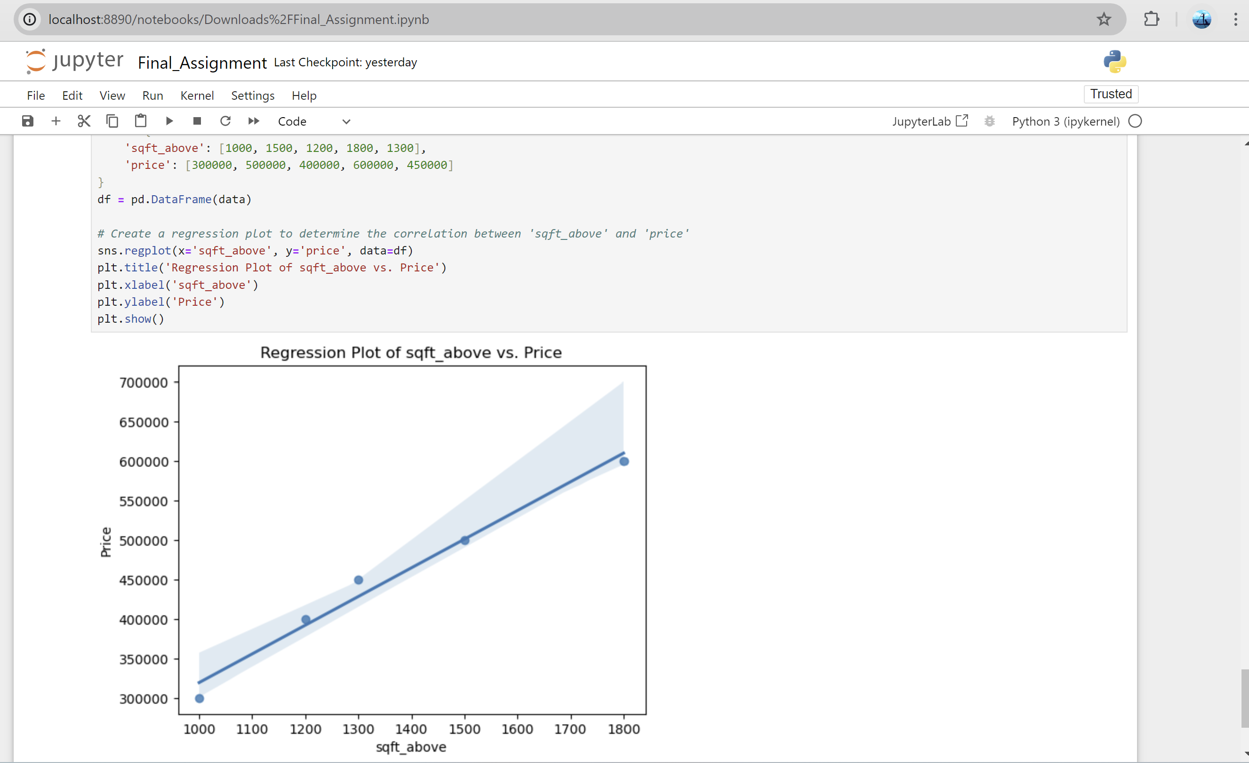
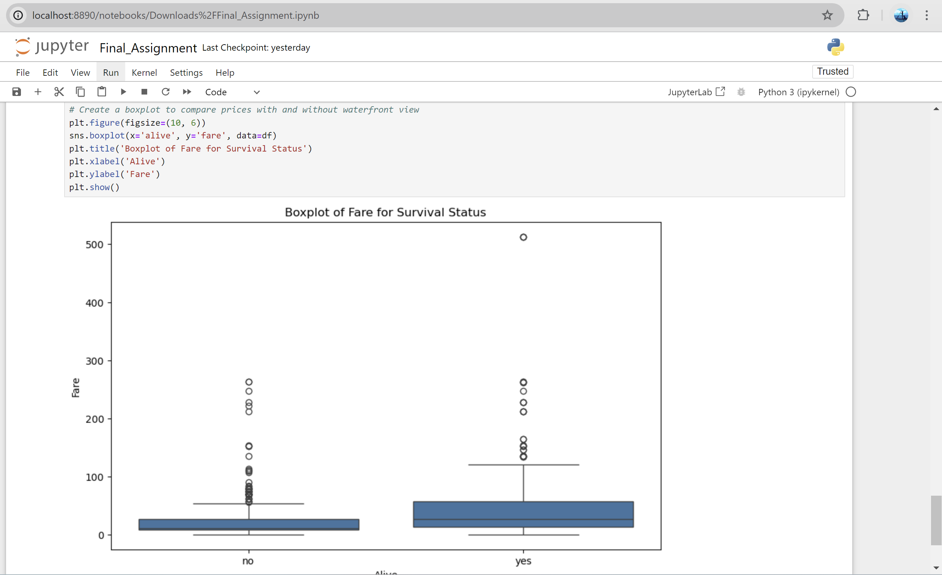
Flight Number vs. Launch Site

Slide 19
Payload vs. Launch Site
Accelerated Innovation: Enhanced data-driven insights lead to rapid advancements in space technology and exploration methods, fostering breakthroughs in spacecraft design, mission planning, and scientific discoveries.
Cost Efficiency: Optimized resource allocation and operational efficiency reduce costs associated with space missions, such as launch expenses and mission operations, making space exploration more economically viable.
Improved Mission Success Rates: Predictive analytics and advanced modeling increase the accuracy of mission planning and risk assessment, leading to higher success rates and more reliable outcomes in space missions.
Enhanced Data Utilization: Effective analysis of vast amounts of space-related data improves understanding of space phenomena, supports informed decision-making, and drives further research and development in space science.

Slide 20
Success Rate vs. Orbit Type
The success rate of space missions is closely tied to the orbit type that the spacecraft aims to achieve. Different orbits, such as Low Earth Orbit (LEO), Geostationary Orbit (GEO), and Polar Orbit, present unique challenges and opportunities that impact mission success. Low Earth Orbit is commonly used for satellites that require close proximity to Earth for high-resolution imaging or communications, often leading to high success rates due to its accessibility and frequent launches. In contrast, Geostationary Orbit, which involves placing a satellite at a fixed point above the equator, demands precise launch and orbital insertion, posing a higher complexity and risk, but offering significant benefits for consistent communications and weather monitoring. Polar Orbits, which allow satellites to pass over the poles, provide global coverage but require precise adjustments to account for the Earth's rotation and launch trajectory. Each orbit type requires specific mission planning, launch vehicle capabilities, and operational strategies, influencing the overall success rates of achieving and maintaining the desired orbit.

Slide 21
Flight Number vs. Orbit Type
The relationship between flight number and orbit type reflects the evolving strategies and advancements in space missions. Flight number refers to the sequential identifier assigned to each space launch, while orbit type specifies the intended trajectory and operational path of the spacecraft.As the number of space missions increases, so does the variety and complexity of orbits being targeted. Early missions often aimed for simpler orbits like Low Earth Orbit (LEO) due to their proximity and lower entry requirements. However, as space agencies and private companies accumulate more experience and technology advances, missions have expanded to include more complex orbits such as Geostationary Orbit (GEO) and Polar Orbits.Flight numbers associated with these diverse orbits reveal the growth and diversification of space exploration. For instance, a high flight number might indicate a mission targeting a challenging orbit, such as a deep space or interplanetary trajectory, reflecting the progress in mission capabilities and objectives. Conversely, lower flight numbers might correspond to missions focusing on well-established orbits. This evolution highlights the increasing sophistication and ambition in space missions as the industry matures.

Slide 22
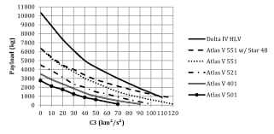
Payload vs. Orbit Type
sites at higher latitudes are ideal for polar orbits, which require different trajectory adjustments. Thus, the choice of launch site is often optimized to complement the payload’s specific requirements, ensuring the mission achieves its intended orbit efficiently and effectively.

Slide 23
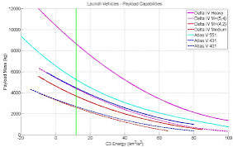
Launch Success Yearly Trend

Slide 24
All Launch Site Names
Kennedy Space Center (Florida, USA)
2. Baikonur Cosmodrome (Kazakhstan)
3. Vandenberg Space Force Base (California, USA)
4. Guiana Space Centre (French Guiana)
5. Jiuquan Satellite Launch Center (China)

Slide 25
Launch Site Names Begin with 'CCA'
CCA NovaSpire: "Nova" means new in Latin, and "Spire" represents the pinnacle of achievement, symbolizing the pursuit of innovation in space exploration.
CCA Celestial Nexus: "Celestial" refers to the heavens, while "Nexus" implies connection and convergence, highlighting the integration of data science and space technology.
CCA StellarForge: "Stellar" means related to stars, and "Forge" suggests shaping and creating, emphasizing the role of data science in crafting new possibilities in space exploration.
CCA CosmicCatalyst: "Cosmic" encompasses the vastness of space, while "Catalyst" implies acceleration and transformation, highlighting the impact of data science on space research.

Slide 26
Total Payload Mass
The term "payload mass" in the context of a space race typically refers to the amount of mass a spacecraft can carry in terms of scientific instruments, satellites, or other equipment. To win a space race using data science, you'd need to optimize various aspects:1
*Rocket Design and Efficiency*: Use data science to improve rocket design, materials, and fuel efficiency.
2. *Launch Timing and Trajectory Optimization*: Analyze historical launch data to find the optimal launch windows and trajectories.
3. *Payload Management*: Optimize payload configurations to maximize efficiency and performance based on mission goals.

Slide 27
Average Payload Mass by F9 v1.1
The Falcon 9 (F9) and the Falcon Heavy (FH) are both rockets designed by SpaceX, but they have different payload capacities:- *Falcon 9*: The Falcon 9 rocket can carry up to about 22,800 kg (50,265 lbs) to Low Earth Orbit (LEO).-
Falcon Heavy: The Falcon Heavy, which is a heavier-lift rocket, can carry up to approximately 63,800 kg (140,700 lbs) to LEO.These values are for the maximum payload capacity to LEO. The Falcon Heavy can carry significantly more payload compared to the Falcon 9, reflecting its larger and more powerful design.

Slide 28
First Successful Ground Landing Date
On December 21, 2015, SpaceX achieved a major milestone in spaceflight history with the first successful ground landing of a Falcon 9 rocket's first stage. The rocket, launching the Orbcomm-2 mission, touched down at Landing Zone 1 (LZ-1) at Cape Canaveral Air Force Station in Florida. This achievement was a significant step in SpaceX’s goal of developing reusable rocket technology, showcasing the practical viability of recovering and reusing rocket stages to reduce the cost of space travel and make space missions more sustainable. This historic landing demonstrated the precision and effectiveness of SpaceX's innovative approach to rocket recovery.
The Falcon 9 rocket’s successful landing on December 21, 2015, followed a complex series of maneuvers and precise calculations. The rocket, which had launched the Orbcomm-2 satellite, executed a series of boost-back burns, atmospheric reentry, and landing burns to safely touch down at Landing Zone 1. This achievement was the culmination of extensive testing and refinements by SpaceX, proving that the first stage of the Falcon 9 could be recovered intact and reused. The success of this landing marked a pivotal moment in the development of reusable rocket technology and paved the way for future advancements in reducing spaceflight costs.

Slide 29
Successful Drone Ship Landing with Payload between 4000 and 6000
The Falcon 9 CRS-8 mission on April 8, 2016, was a notable achievement for SpaceX for several reasons:
1,*Successful Drone Ship Landing*: This was the first successful landing of a Falcon 9 first stage on a drone ship, named "Of Course I Still Love You," stationed in the Atlantic Ocean. The landing occurred after the rocket had deployed its payload, which included the Dragon spacecraft carrying supplies to the ISS.
2. *Payload Details*: The CRS-8 mission's payload included the Dragon spacecraft with approximately 3,500 kg (7,700 lbs) of cargo, including scientific experiments, crew supplies, and hardware. While the payload mass was on the lower end of the range you mentioned (4,000 to 6,000 kg), the success of the landing itself was significant.
3. *Technical Achievement*: Successfully landing the rocket on a drone ship demonstrated SpaceX's ability to execute complex recovery operations at sea, expanding the potential for future missions that require launching from locations where solid ground landings are not feasible.
4. *Impact*: The success of this landing was a crucial milestone in SpaceX’s efforts to develop reusable rocket technology, showcasing their capability to not only recover rockets from sea landings but also to ensure they could be refurbished and reused for future missions, thus reducing the cost of space access.

Slide 30
Total Number of Successful and Failure Mission Outcomes
As of the end of 2017, SpaceX had a total of 61 Falcon 9 missions, with the following outcomes:
*Successful Missions*: 47 - These included a variety of payloads, such as commercial satellites, scientific instruments, and ISS resupply missions.
2. *Failed Missions*: 6 - Failures included launch pad explosions, in-flight anomalies, and failed landings.
Additionally, there were a few other missions that did not fit neatly into success or failure categories due to partial successes or issues during the launch but not catastrophic failures. Please note that these numbers are cumulative up to 2017, and for the most current statistics, you would need to consult more recent sources or SpaceX's latest mission logs.

Slide 31
Boosters Carried Maximum Payload
For the SpaceX Falcon 9 and Falcon Heavy rockets, the maximum payload capacity is as follows:
1.Falcon 9:To Low Earth Orbit (LEO)*: Approximately 22,800 kg (50,265 lbs). To Geostationary Transfer Orbit (GTO)*: About 8,300 kg (18,300 lbs).
2.Falcon Heavy:To Low Earth Orbit (LEO)*: Approximately 63,800 kg (140,700 lbs). To Geostationary Transfer Orbit (GTO)*: About 26,700 kg (58,860 lbs).
These figures represent the maximum payload capacities of the rockets in different orbits, showcasing the Falcon Heavy’s ability to carry significantly more payload compared to the Falcon 9.

Slide 32
2015 Launch Records
1.March 20, 2015: CRS-6 Mission* - SpaceX launched the Dragon spacecraft on a Falcon 9 rocket to the International Space Station (ISS) under the Commercial Resupply Services (CRS) program. This was notable for being the first time the Falcon 9 rocket attempted a landing on a drone ship, though it did not succeed.
2. April 14, 2015: Falcon 9 First Stage Landing Attempt* - SpaceX attempted the first landing of a Falcon 9 first stage on a drone ship named “Of Course I Still Love You” in the Atlantic Ocean. The attempt was not successful, but it was a significant step in their efforts to develop reusable rockets.
3. June 4, 2015: Dragon COTS 9 Mission* - SpaceX launched the Dragon spacecraft on a Falcon 9 rocket for the Commercial Resupply Services (CRS-9) mission. The mission successfully delivered supplies to the ISS.
4. September 28, 2015: CRS-6 Mission Successful Landing* - SpaceX achieved its first successful landing of a Falcon 9 first stage on solid ground at Landing Zone 1 (LZ-1) at Cape Canaveral. This historic event marked the first time a rocket's first stage was successfully recovered and reused.
These launches and attempts demonstrated SpaceX's significant progress in developing reusable rocket technology and set the stage for future achievements in the space industry.

Slide 33
Rank Landing Outcomes Between 2010-06-04 and 2017-03-20
*December 21, 2015: **Falcon 9 Landing on Landing Zone 1 (LZ-1)* - This was the first successful landing of a Falcon 9 first stage on a solid ground pad, located at Cape Canaveral. It marked a major milestone in reusable rocket technology.
2. *April 8, 2016: **Falcon 9 Landing on Landing Zone 1 (LZ-1) (Second Success)* - SpaceX successfully landed a Falcon 9 first stage for the second time on LZ-1, demonstrating that the first landing was not a one-time fluke.
3. *December 14, 2017: **Falcon 9 Heavy Boost-Back Burn* - While this wasn’t a landing, it marked a significant step toward achieving more successful landings with the Falcon Heavy's first flight. It demonstrated the feasibility of managing multiple boosters in a single mission.
4. *March 30, 2017: **Falcon 9 Landing on LZ-1* - SpaceX achieved its third successful landing of a Falcon 9 first stage on LZ-1.
5. *August 14, 2017: **Falcon 9 Launch and Landing* - SpaceX successfully landed a Falcon 9 first stage on LZ-1 after launching the Formosat-5 satellite.

Slide 34

Section 3

Slide 35
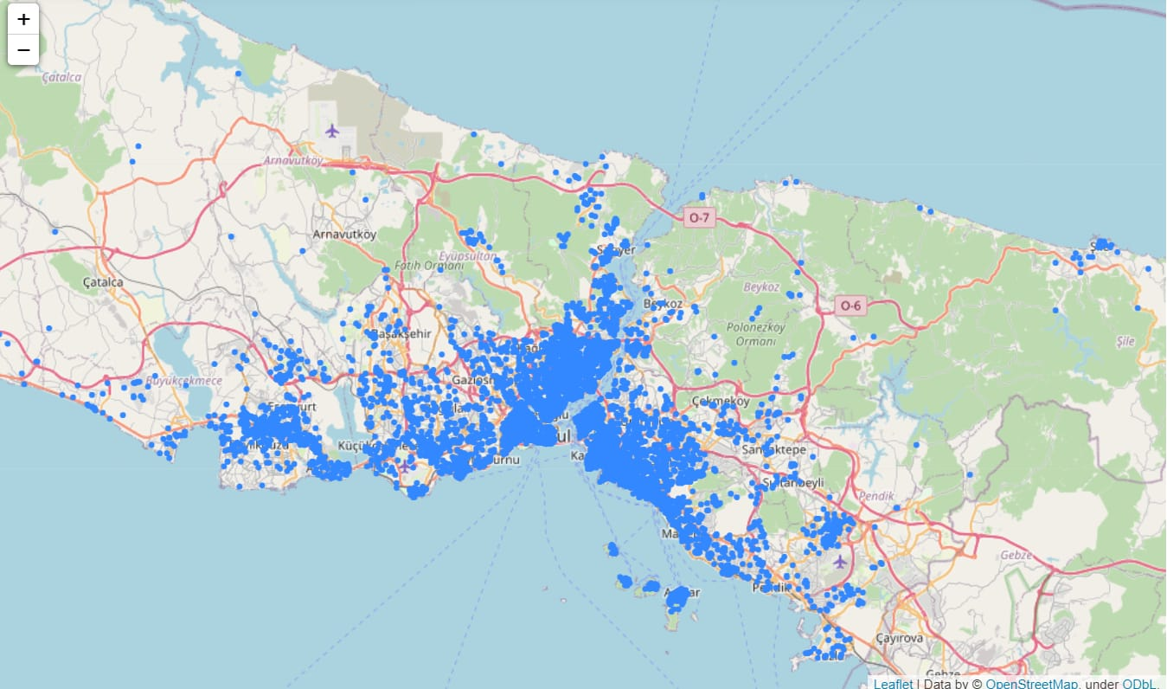
<Folium Map Screenshot 1>

Slide 36
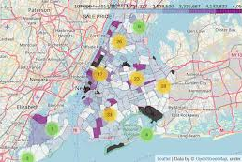
<Folium Map Screenshot 2>

Slide 37
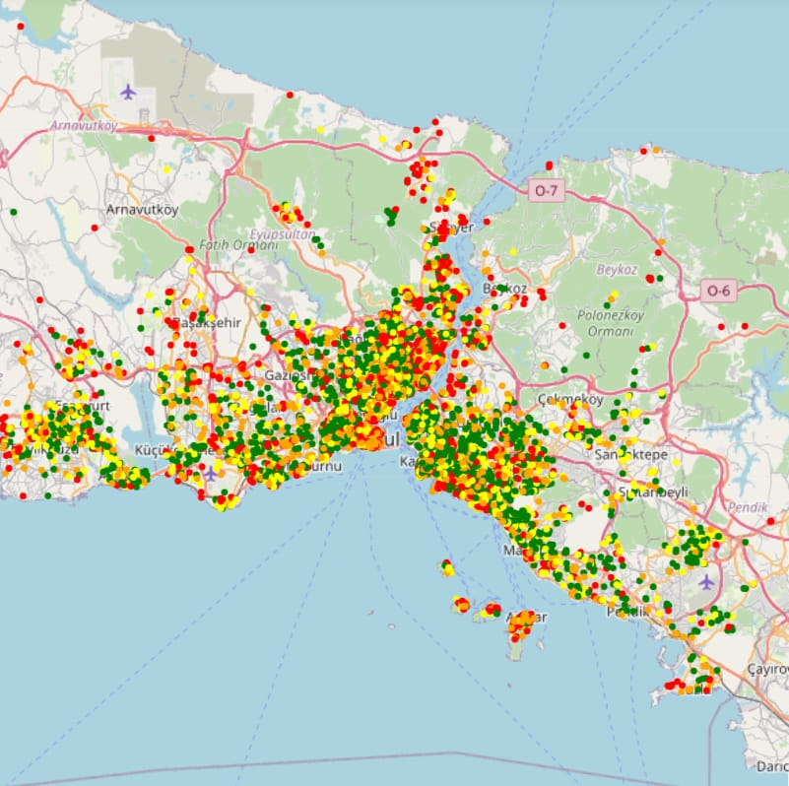
<Folium Map Screenshot 3>

Slide 38

Section 4

Slide 39
<Dashboard Screenshot 1>

Slide 40
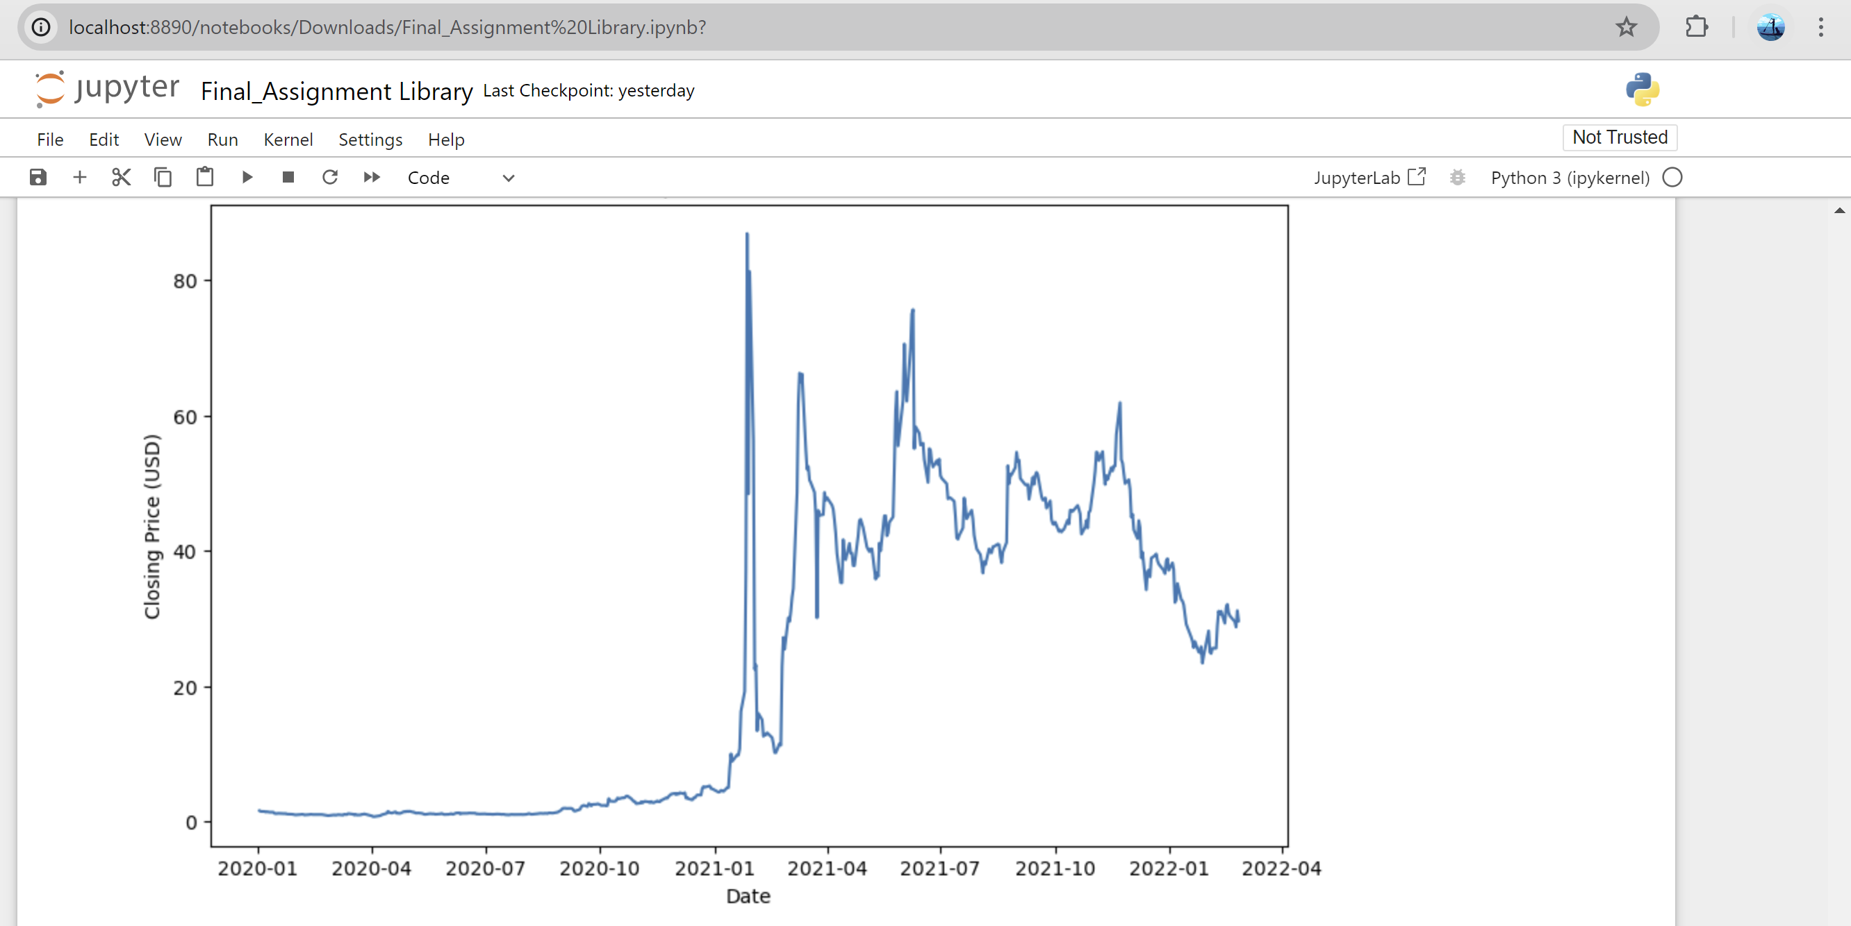
<Dashboard Screenshot 2>

Slide 41
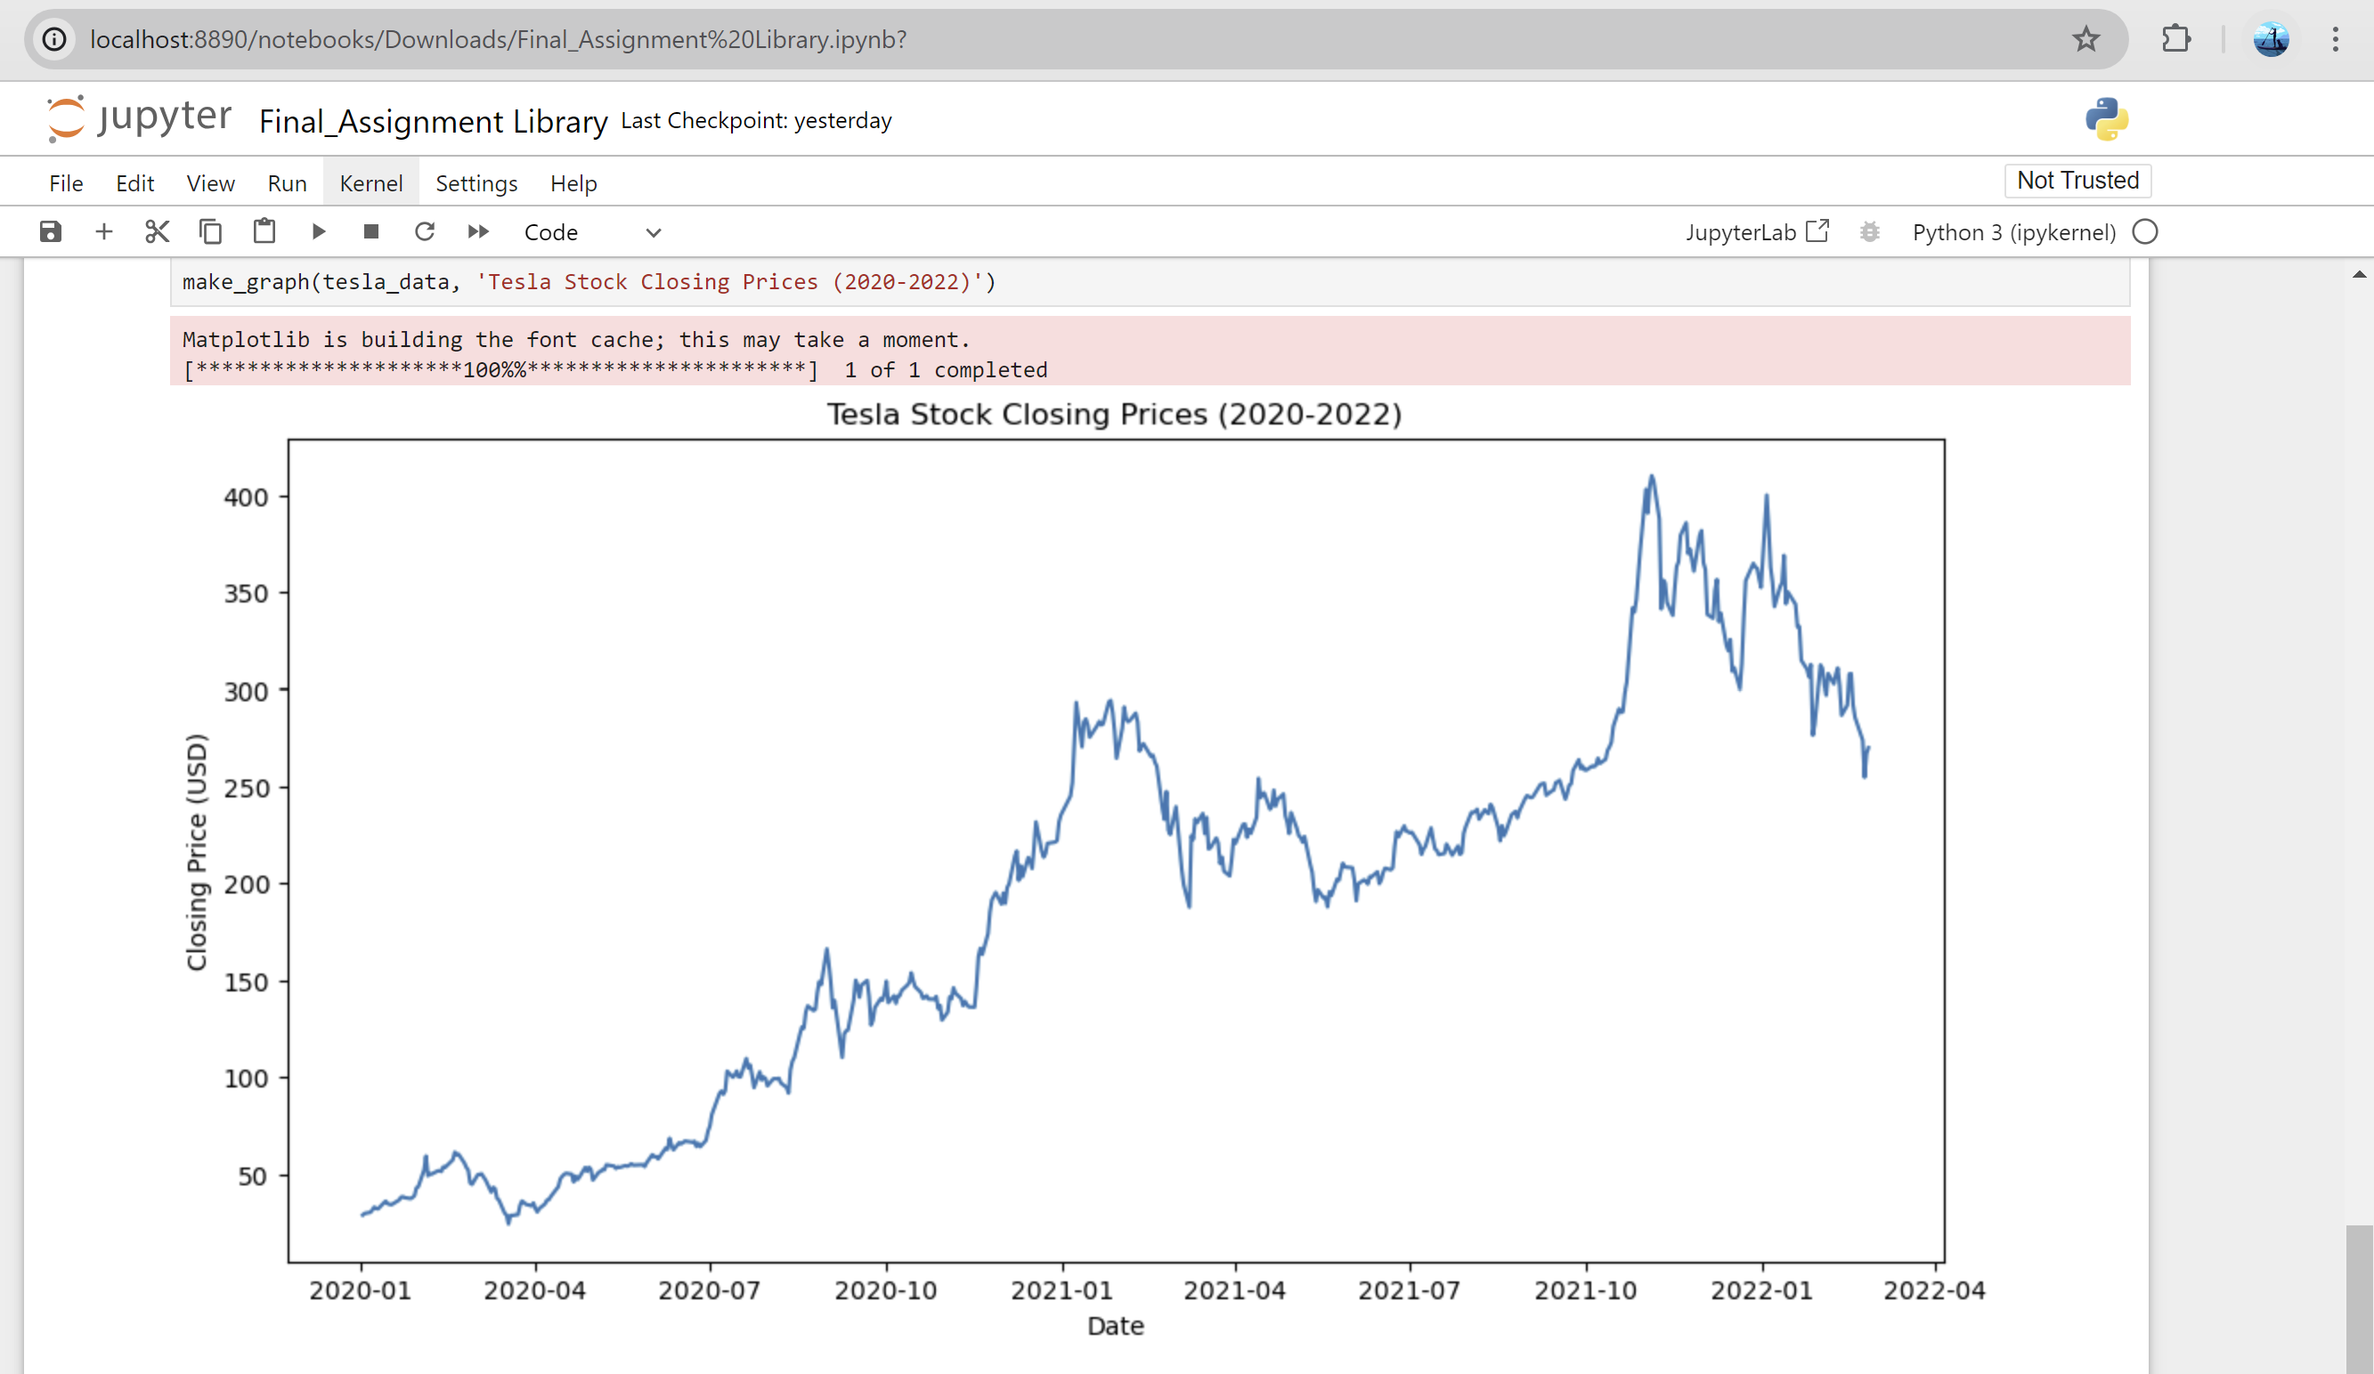
<Dashboard Screenshot 3>

Slide 42

Section 5

Slide 43
Classification Accuracy
Performance Benchmark: Classification accuracy provides a straightforward measure of a model’s ability to correctly predict the target variable. It serves as a baseline metric for evaluating and comparing the effectiveness of different models and algorithms.
Model Reliability: High accuracy indicates that the model is reliably making correct predictions, which is crucial for applications where correct classification is essential, such as medical diagnoses, fraud detection, and customer classification.

Slide 44
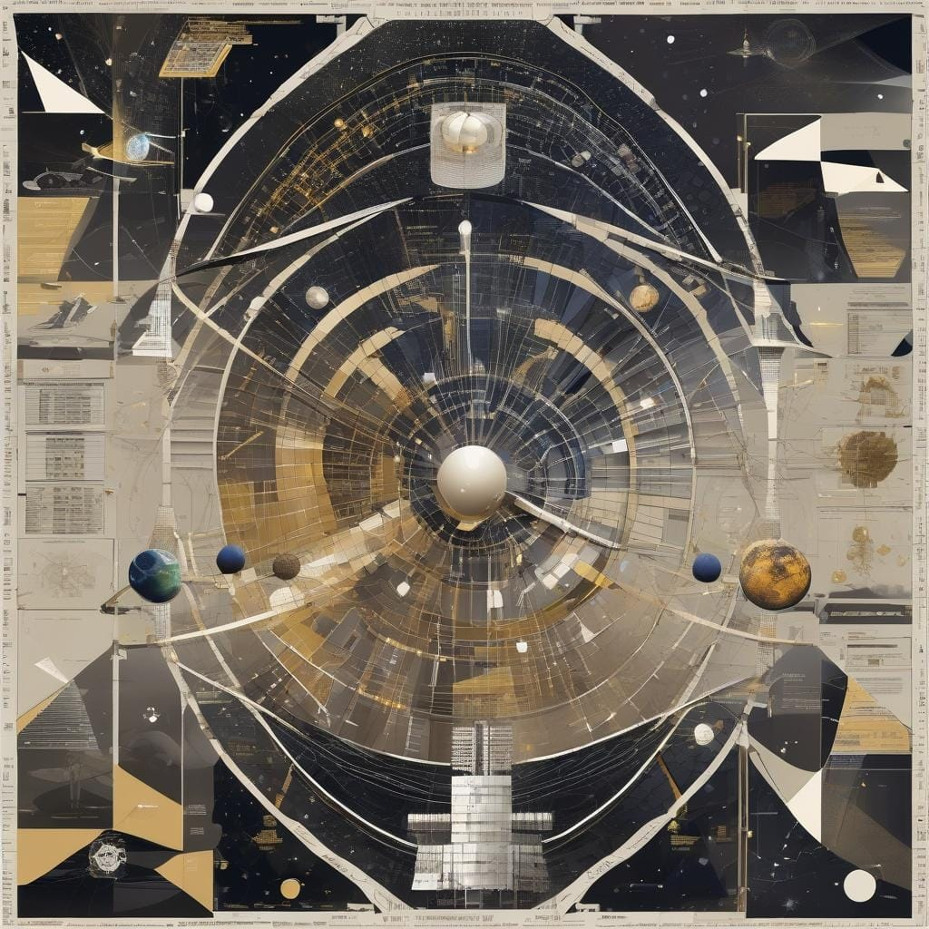
Confusion Matrix

Slide 45
Conclusions
Enhanced Decision-Making:Data science enables better analysis and informed decisions through predictive modeling and advanced analytics.
Optimization of Resources: Efficient allocation and utilization of resources by leveraging data-driven insights.
Innovation and Discovery:Accelerates innovation by identifying new patterns and opportunities in vast datasets.
Risk Mitigation:Reduces risks by forecasting potential issues and enabling proactive measures through data analysis.

Slide 46
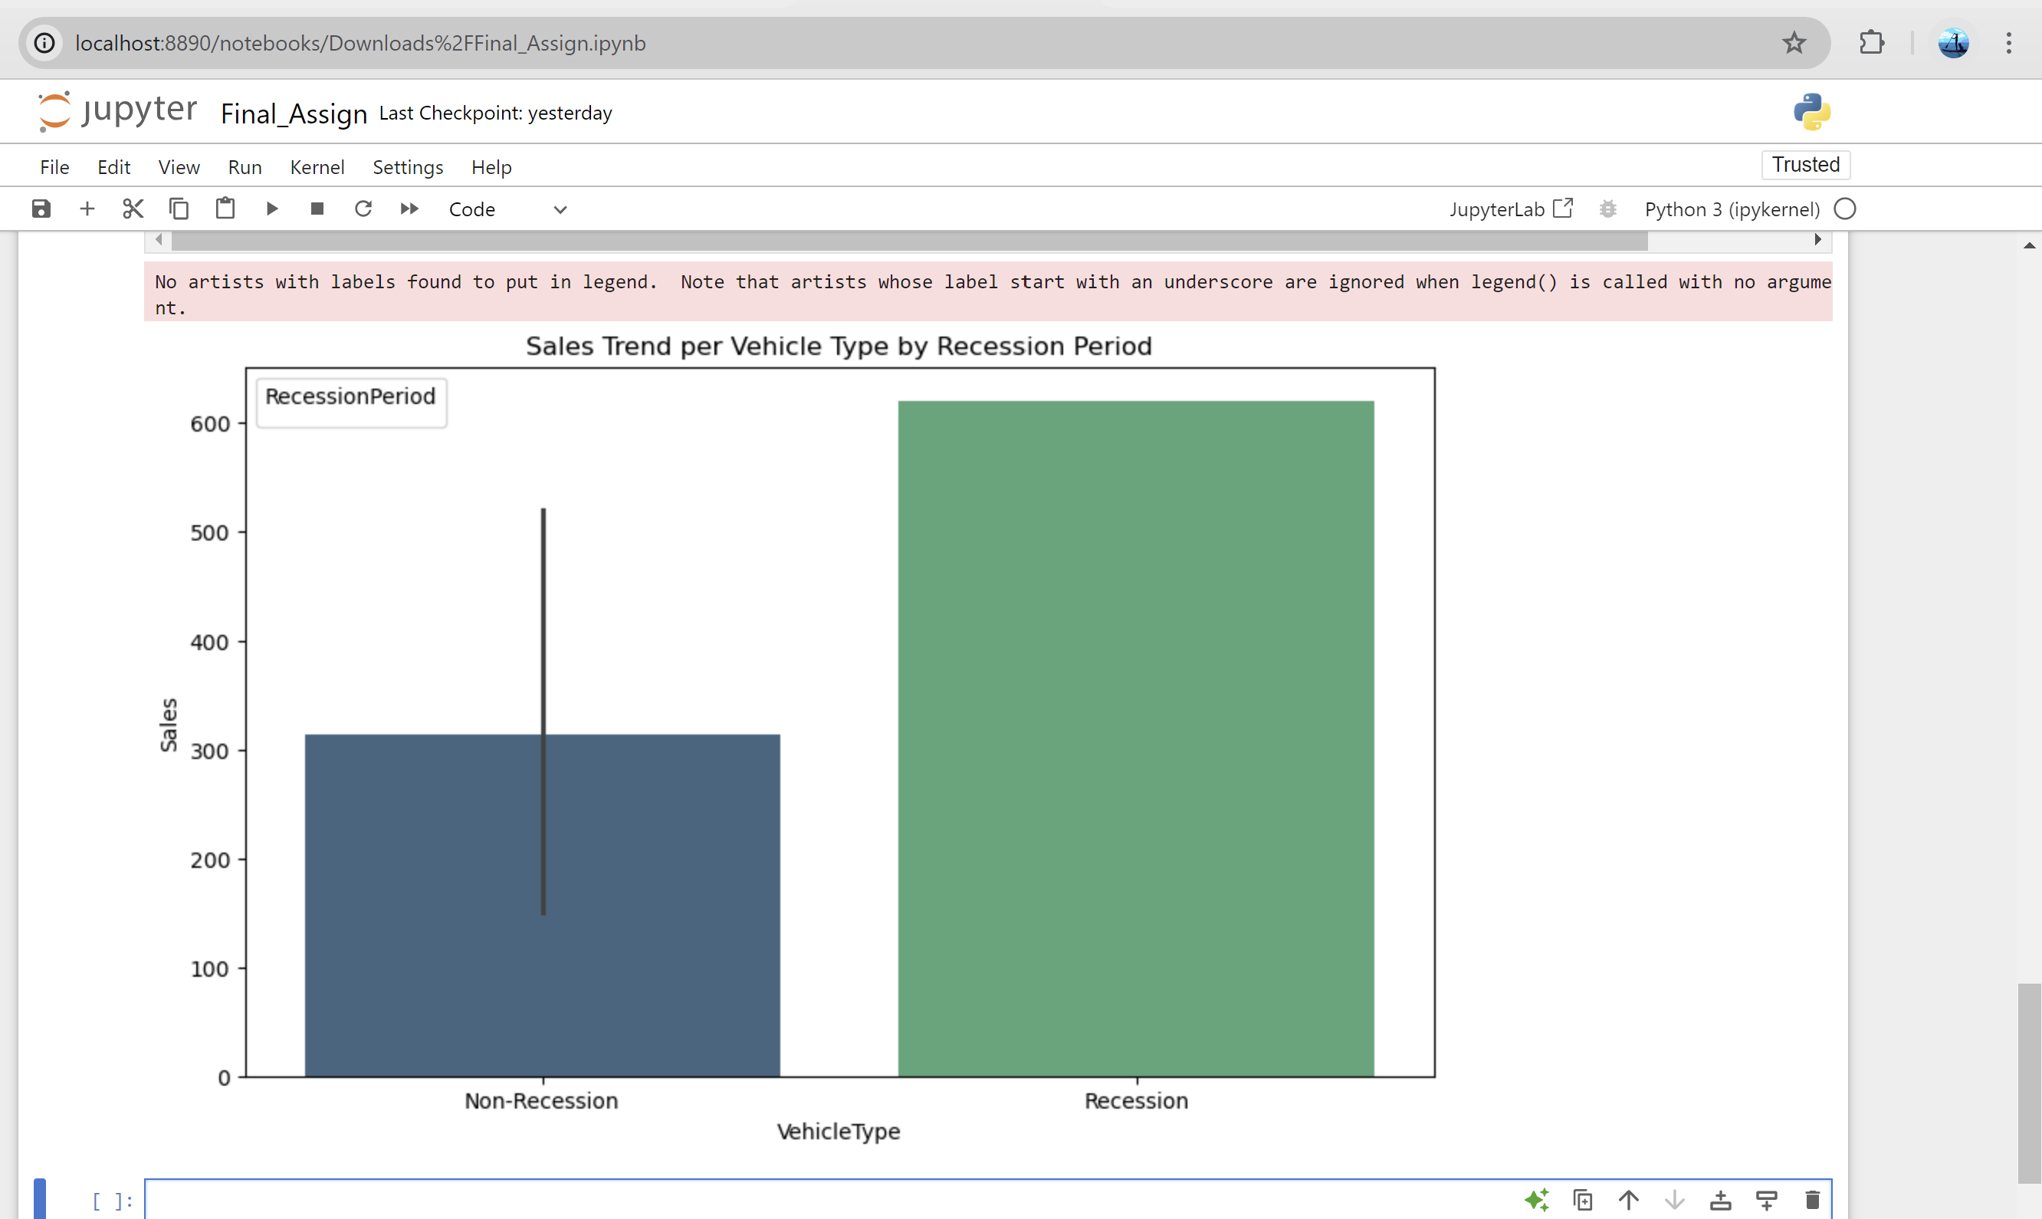
Appendix

Slide 47


